Slide 1
Governance Framework
Governance is something which is very important and ensuring that customers can trust us with their data is essential in these times with increasing cyber attacks and the importance of data in general.
Approach
Create a Data Governance Framework which sets sensitivity at a table and column level which is hierarchical.
Each project has the following groups created:
Public – Data can be seen by anyone with access
Internal – some degree of sensitivity address , usernames etc
Sensitive – telephone numbers bank account details etc
If no table level is set then it is by default Public
Downstream tables inherit the permissions of their parent.
Users are then given access to the group for what they can see. Not even data Engineers are given sensitive if not needed,

Slide 2
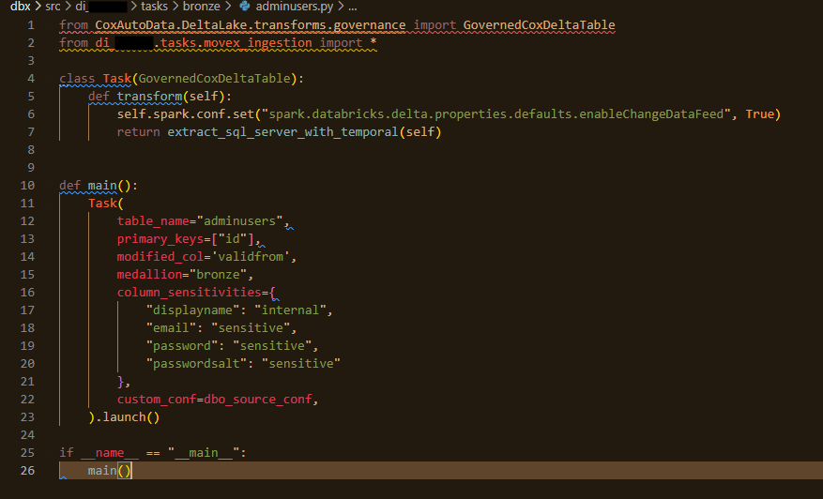
Implementation
This is done in Bronze
Fields are dropped out in Silver if not needed

Slide 3
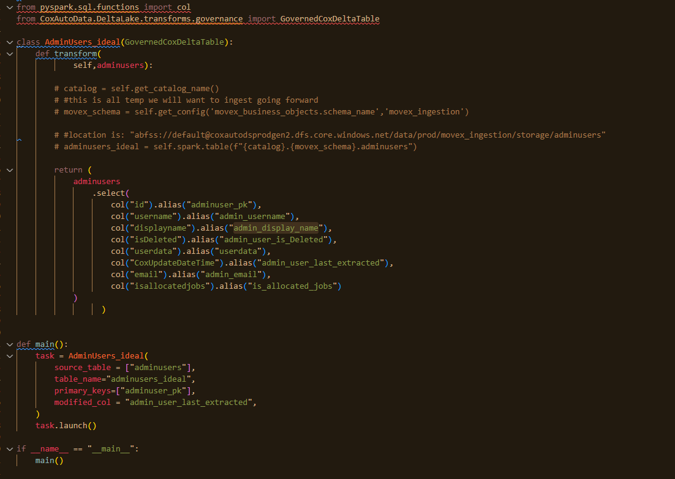
Implementation

Slide 4
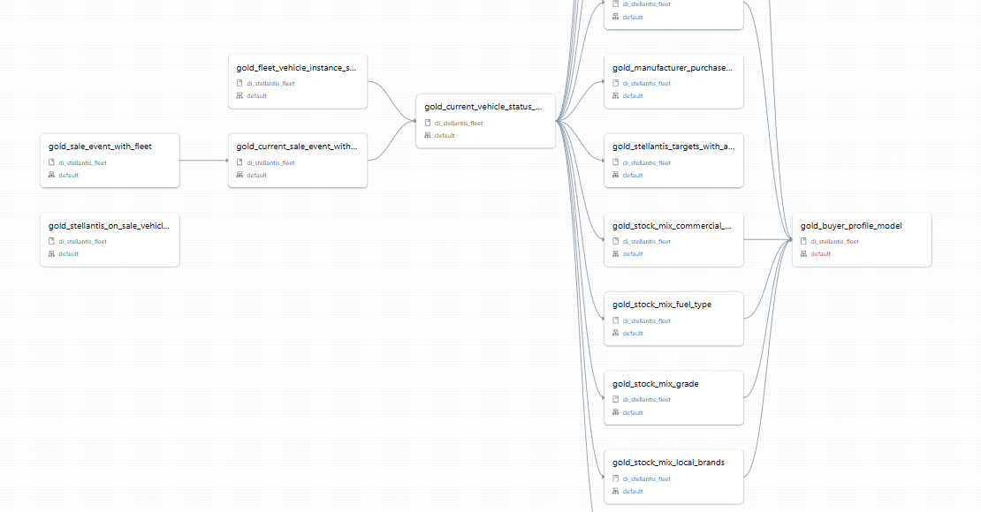
Implementation

Slide 5
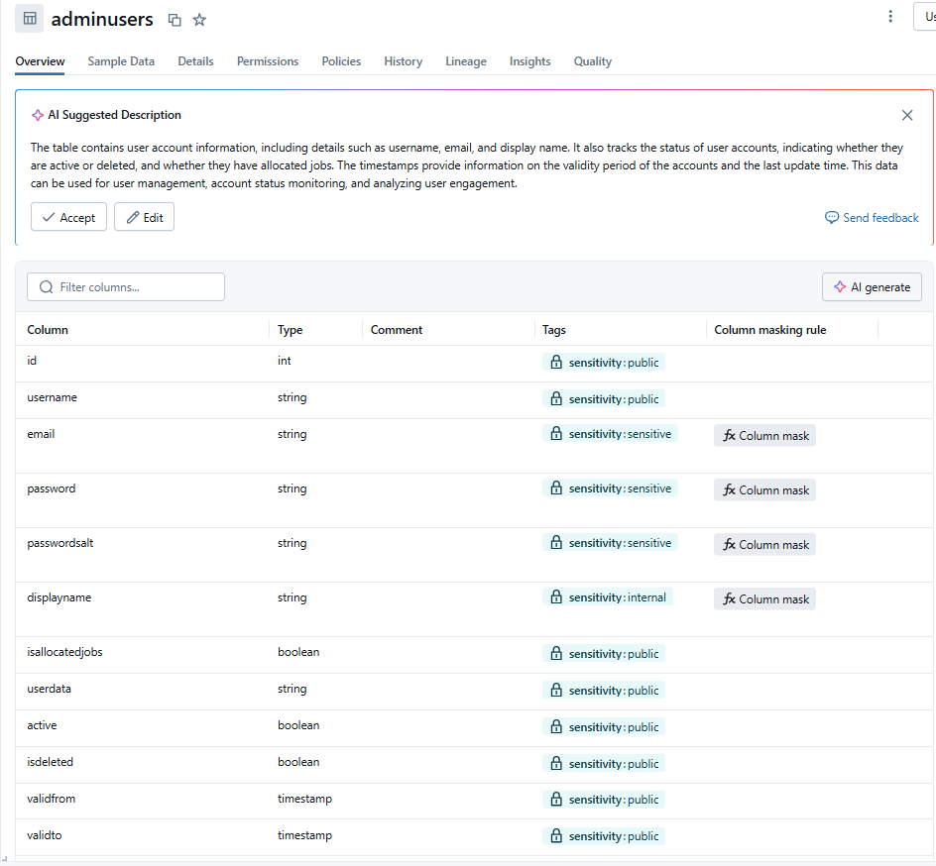
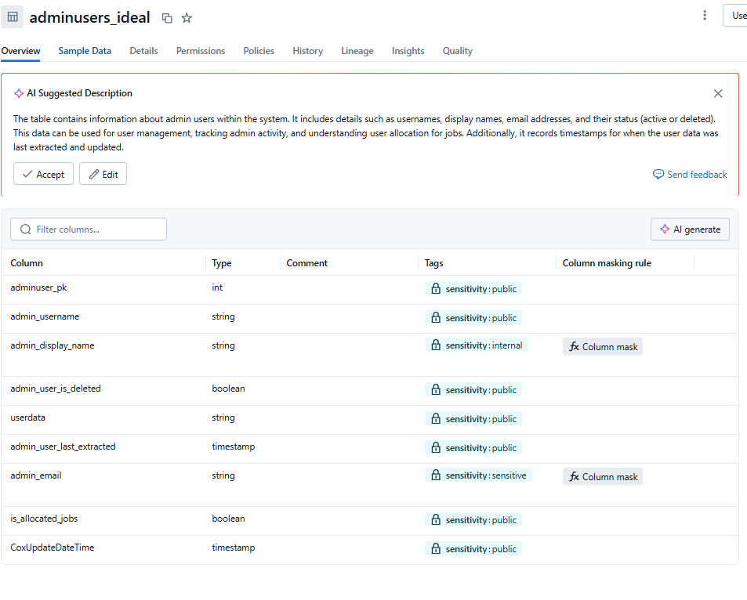
Implementation

Slide 6
Row level Security
Ensuring users can only see what they should is very important , especially when dealing with external user’s reporting. We have solved this in Power BI and Tableau

Slide 7
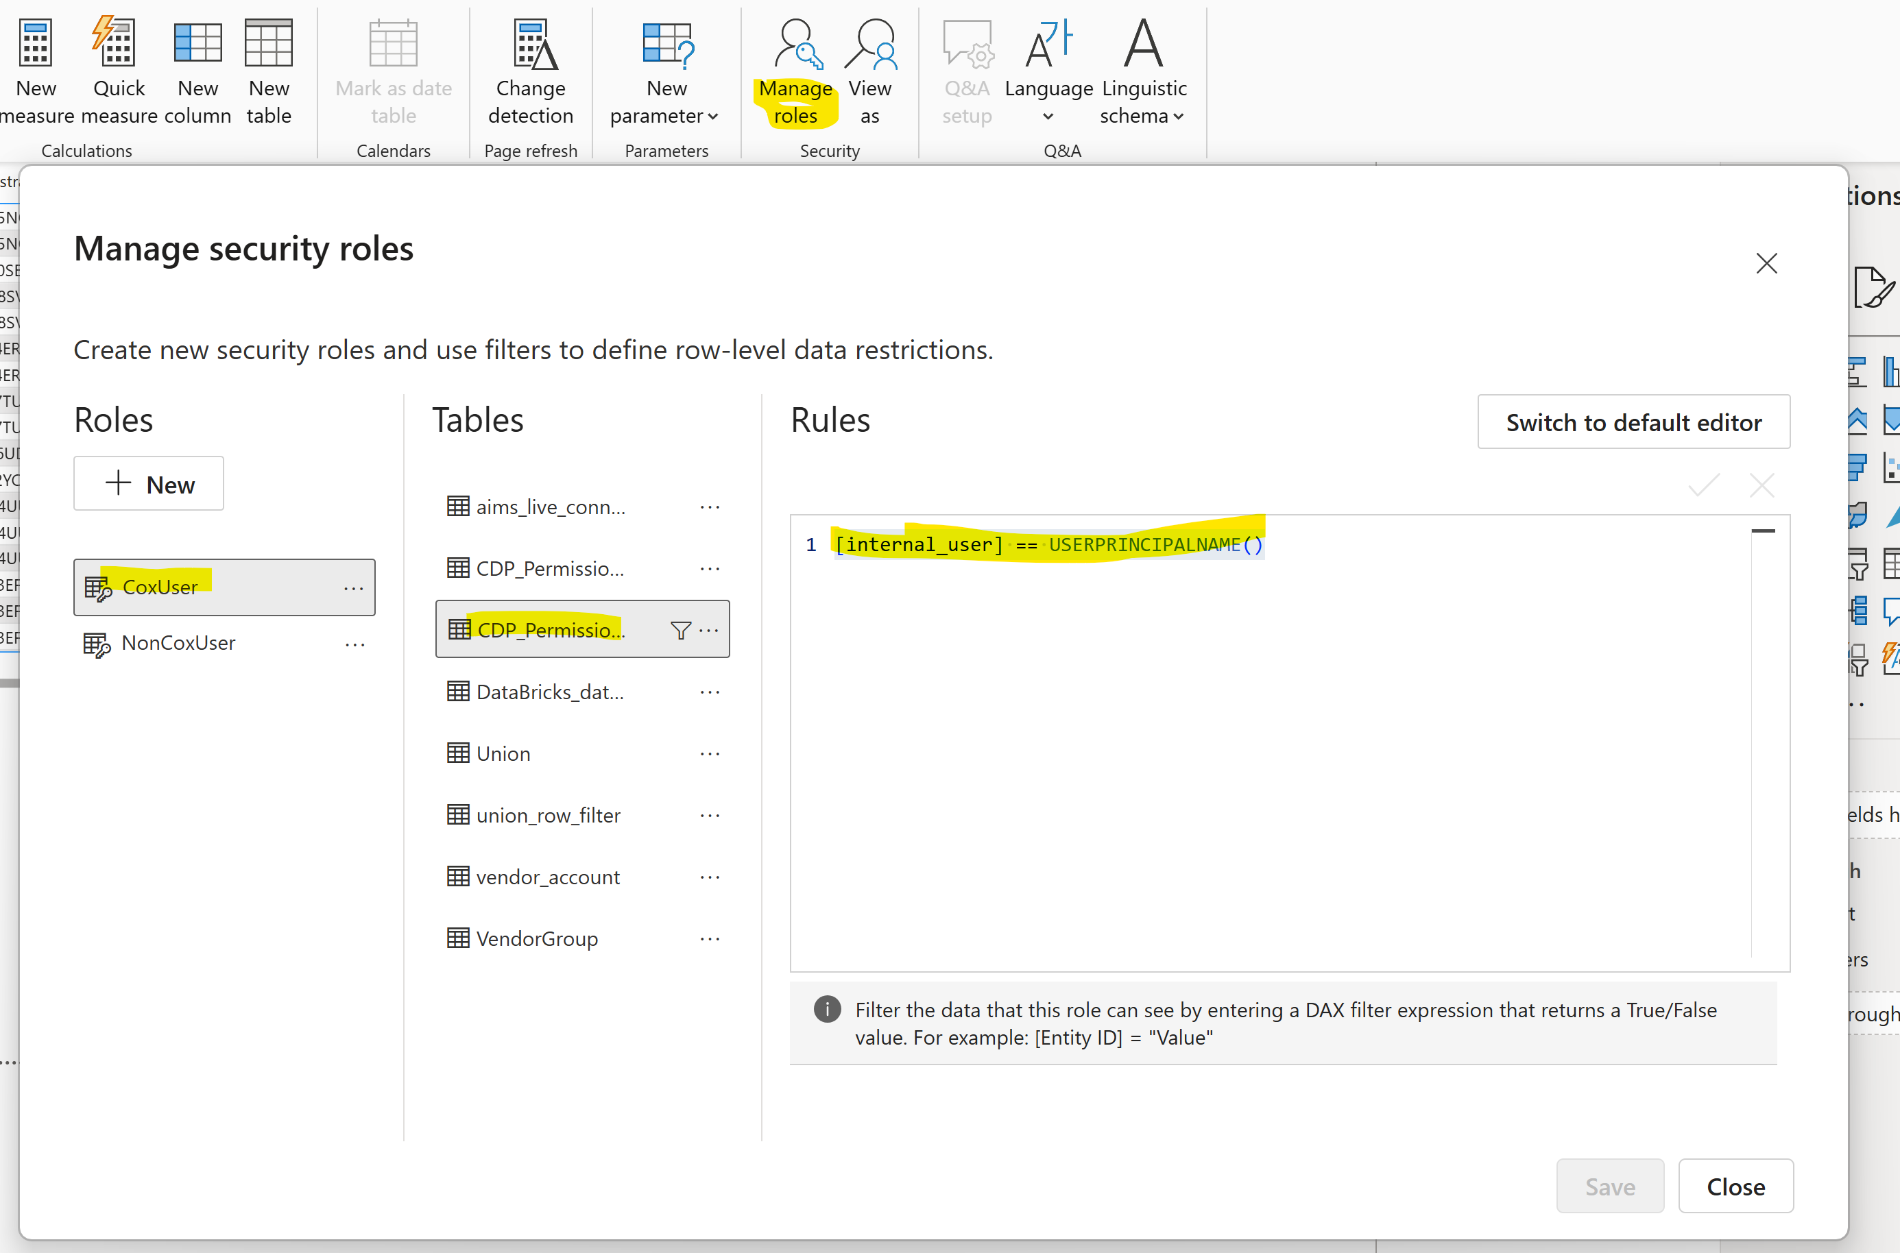
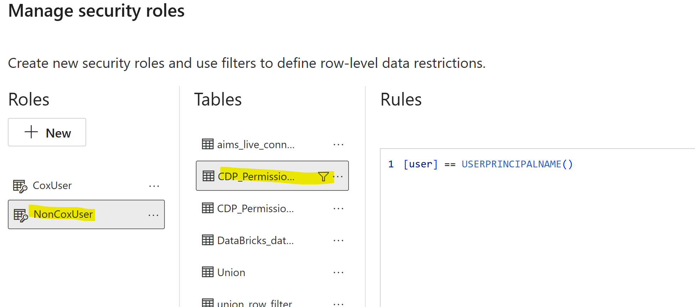
Implementation

Slide 8
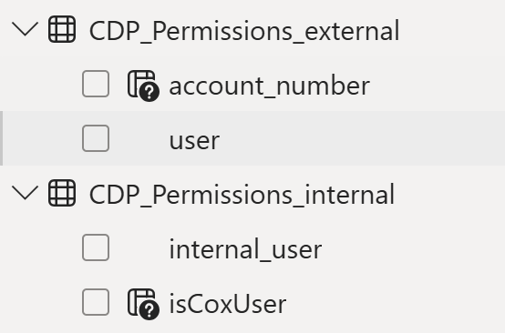
Implementation

Slide 9
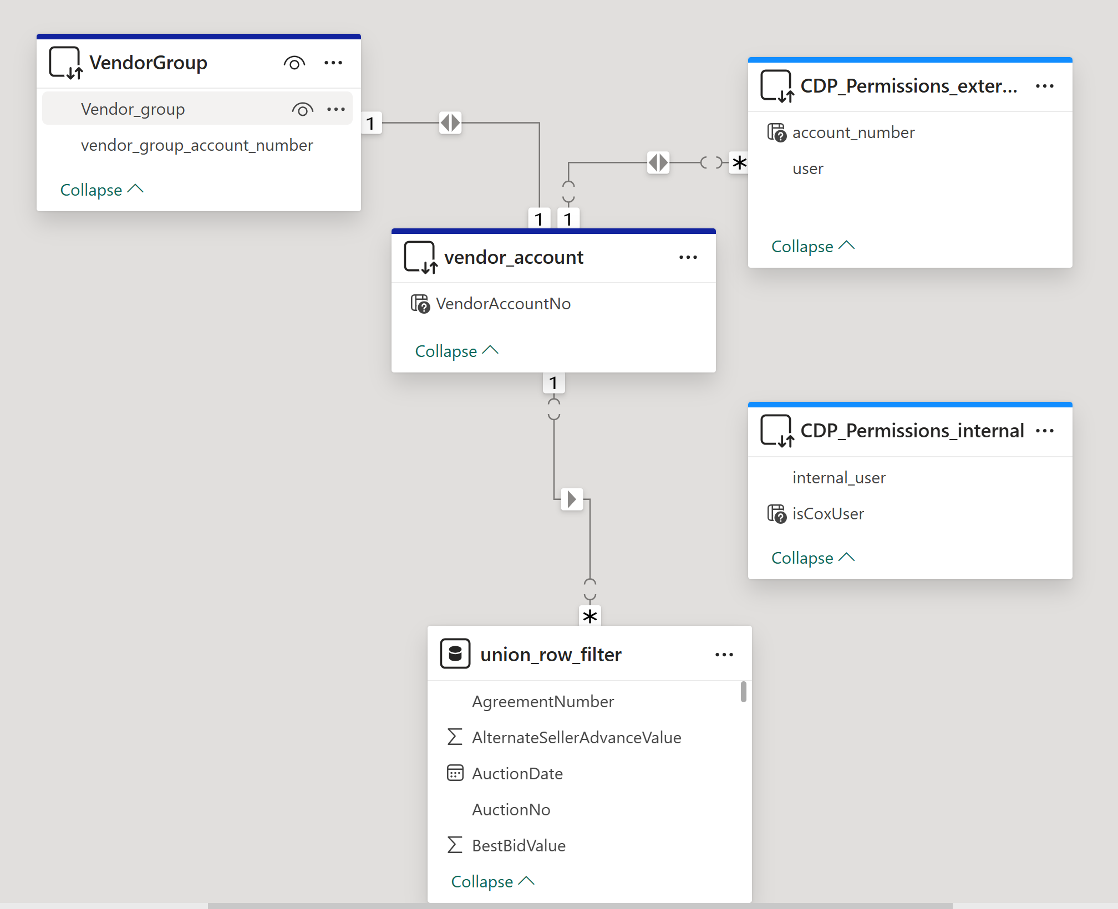
Implementation

